Slide 1
Diabetic Hospitalizations & Readmittance
Celina McBrayer

Slide 2
About Me
M.S.D.A. Candidate at Western Governors University
Bachelor of Science from Texas A&M University – Corpus Christi
Major: Computer Science
Minor: Business

Slide 3
Purpose
The purpose of this study is to create a predictive model to forecast the likelihood of hospital readmittance for diabetic patients and identify factors which might prevent a patient from having to return for the same symptoms.

Slide 4
Benefits of Study
One in ten Americans currently lives with diabetes (American Diabetes Association, 2018) and the impact of readmitting a patient to a hospital might affect that facility’s finances (HealthStream, 2018). By determining factors that might influence readmission rates, a hospital could potentially save thousands of dollars.
Along with overall better patient safety and care, reducing hospital readmission rates might also increase hospital brand trust.

Slide 5
Research Question & Hypothesis
Question: Is there a significant difference in hospital readmittance for people currently taking diabetic medication?
H₀: There is not a significant difference in hospital readmittance for people currently taking diabetic medication.
H₁: There is not a significant difference in hospital readmittance for people currently taking diabetic medication.

Slide 6
Data
Data was gathered from the Health Facts database. This particular data set included 101,766 observations and 50 variables regarding diabetic patients’ hospital stays and readmissions. All information has been deidentified for usage in this study.
Variables analyzed within this study include: gender, race, age, number of inpatient/outpatient procedures, number of medications, A1C results, diabetes medication, and readmittance.

Slide 7
Data Analysis Process – Data Cleansing
Summary statistics were calculated in order to investigate any potential outliers.
Certain variables were omitted due to large proportions of missing information. Other variables were omitted due to their collinearity with other variables.
Duplicate patients were removed from the data, as this would violate the independence assumption for the logistic regression (Shreve & Holland, 2018).
Patients whose hospitalizations resulted in death or transfer to hospice were also removed from the data set.

Slide 8
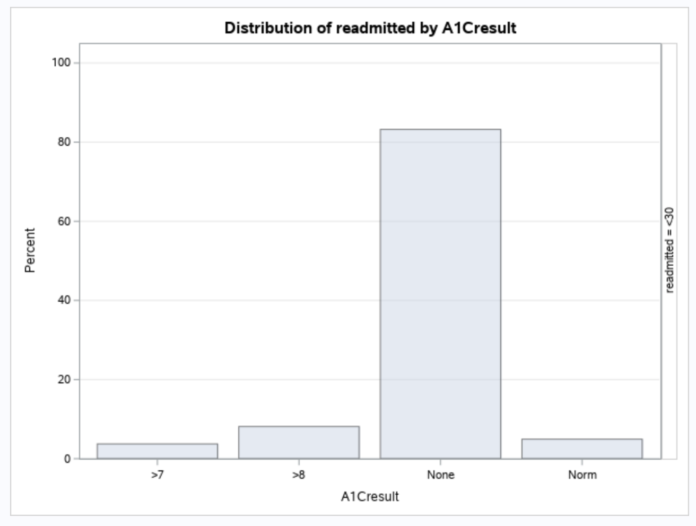
Data Analysis Process – Frequency Plots

Slide 9
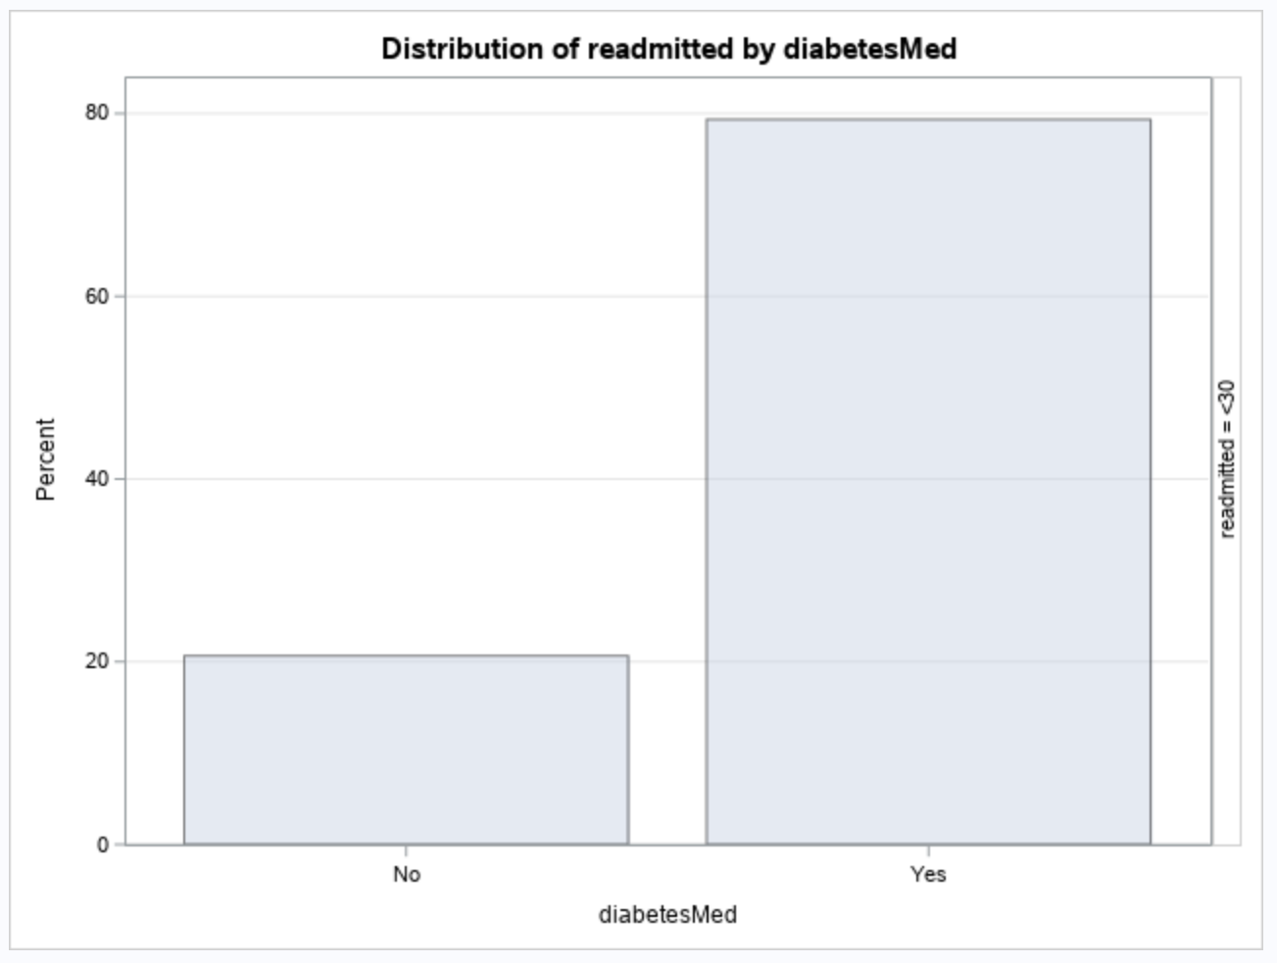
Data Analysis Process – Frequency Plots

Slide 10
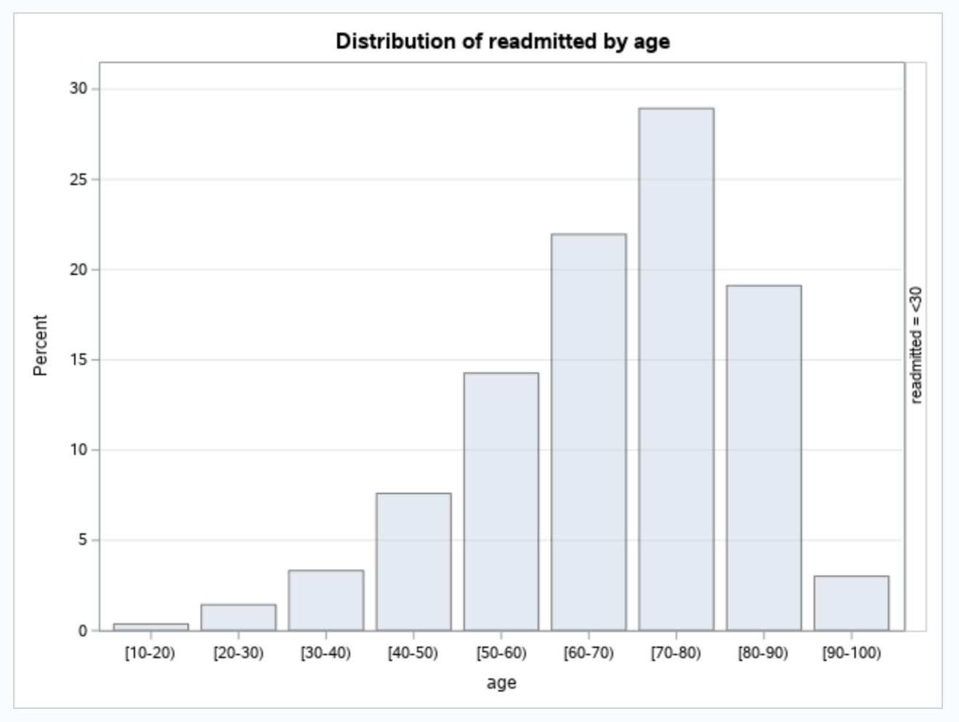
Data Analysis Process – Frequency Plots

Slide 11
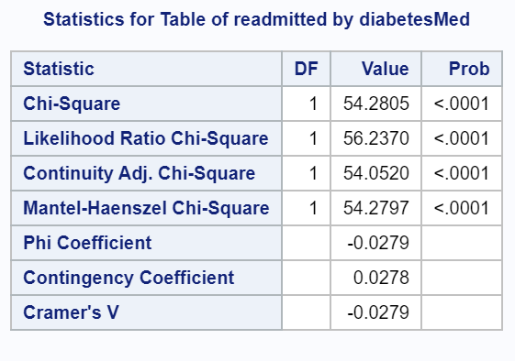
Data Analysis Process – Chi-Square Test
At the 0.05 level, the null hypothesis of no relationship between diabetesMed and readmitted would be rejected. There is enough evidence to suggest a relationship does exist between a patient taking diabetes medication and being readmitted to the hospital.

Slide 12
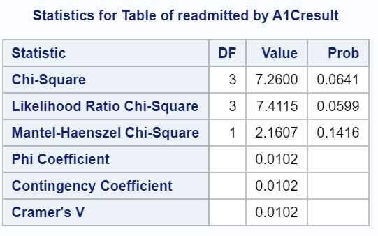
Data Analysis Process – Chi-Square Test
At the 0.05 level, the null hypothesis of no relationship between A1C result and readmitted would fail to be rejected, as its value is 6.4%. However, at a level of significance of 10%, the null hypothesis would be rejected, as there would be evidence that there is an association between A1Cresult and readmittance.

Slide 13
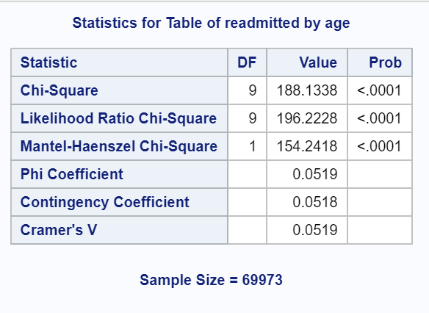
Data Analysis Process – Chi-Square Test
Similarly, at the 0.05 significance level, the null hypothesis of no relationship between age and readmittance would be rejected. There is significant evidence to conclude there is an association between age and being readmitted to the hospital for diabetic patients.

Slide 14
Data Analysis Process – Logistic Regression
Summary of Stepwise Selection
Step | Effect |  | DF | Number In | Score Chi-Square | Pr > ChiSq
 | Entered | Removed
1 | num_inpatient |  | 1 | 1 | 466.9292 | <.0001
2 | time_in_hospital |  | 1 | 2 | 129.6809 | <.0001
3 | diabetesMed |  | 1 | 3 | 14.5291 | 0.0001
4 | num_emergency |  | 1 | 4 | 7.0468 | 0.0079
5 | A1Cresult |  | 3 | 5 | 11.2445 | 0.0105
6 | num_lab_ procedures |  | 1 | 6 | 4.2749 | 0.0387

Slide 15
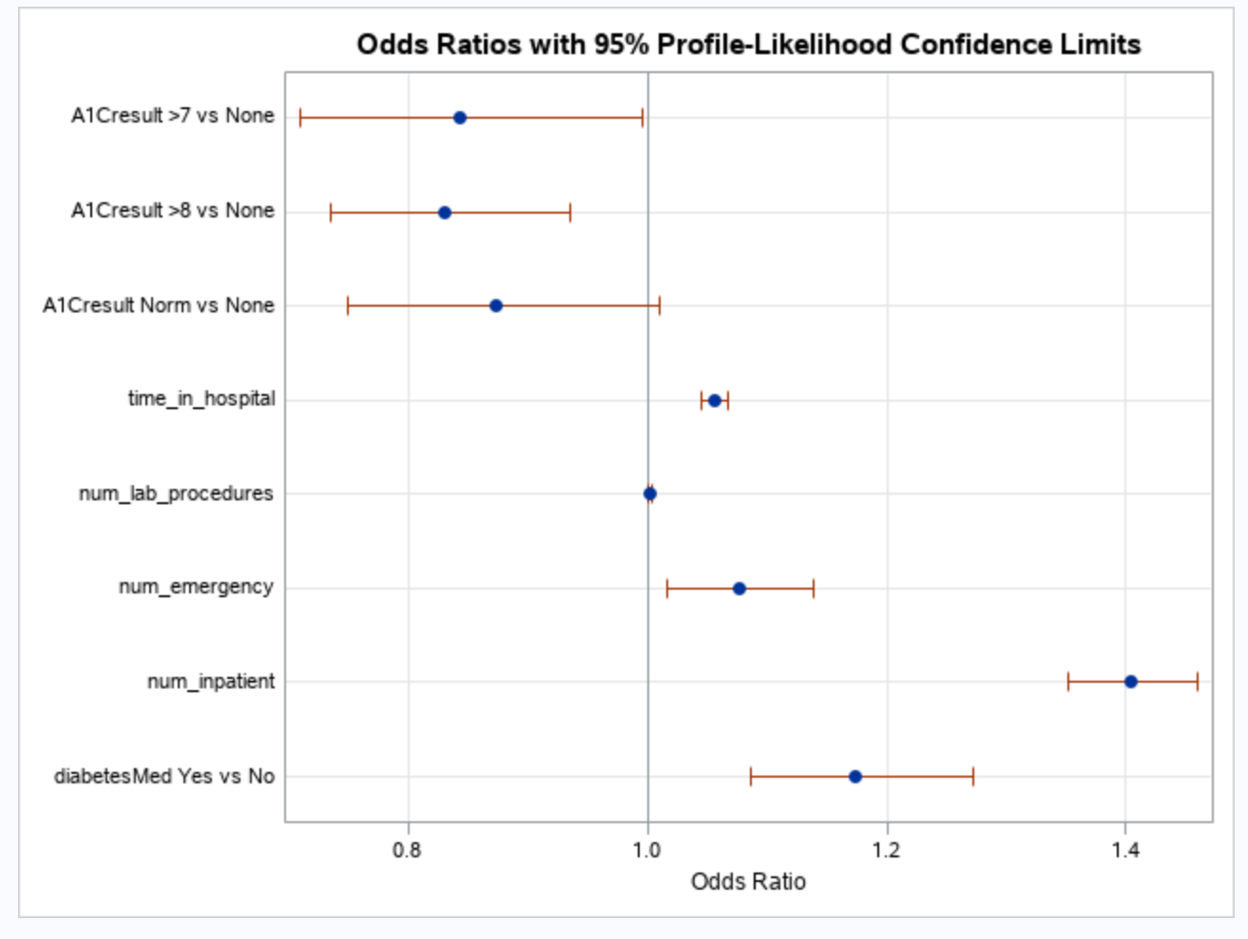
Data Analysis Process – Odds Ratio

Slide 16
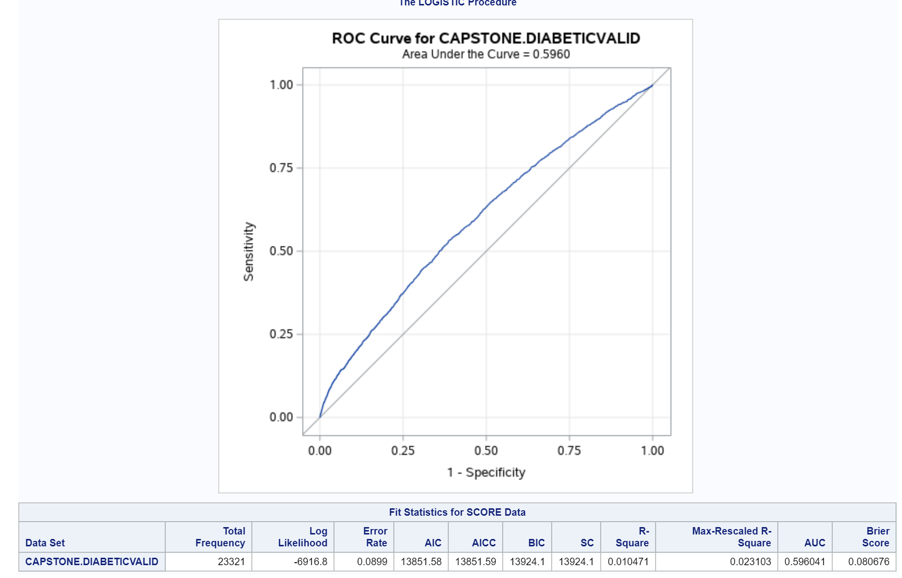
Data Analysis Process – Logistic Regression

Slide 17
Summary of Results
In context of the research question, using the p-value for the chi-square statistic, there does appear to be a relationship between a patient taking diabetic medication and that patient being readmitted to the hospital. Based on the chi-squared information, it is imperative to look more closely at those patients who are currently on medication and possibly determine whether or not that medication is controlling the patient’s current sugar levels or having some negative side effect on the patient, thus causing the hospital visits.

Slide 18
Limitations
The predictive model only has about 60% accuracy. This is not as strong as it could be, perhaps due to limitations of data collection not being specific to this study. In terms of future study, the predictive model certainly has room for improvement. Perhaps, by adding additional factors, not necessarily available within this data set, a higher c-statistic and ROC curve can be achieved. Furthermore, those patients who have diabetes could possibly have other diagnoses with their hospital stay, and there is potential that these accompanying illnesses are the true cause of the patients’ return. An additional column identifying other medical issues might be more helpful in designing a predictive model.

Slide 19
Sources
American Diabetes Association. (2018). Statistics About Diabetes. Retrieved June 1, 2021, from https://www.diabetes.org/resources/statistics/statistics-about-diabetes
BioMed Research International: Beata Strack, Jonathan P. DeShazo, Chris Gennings, Juan L. Olmo, Sebastian Ventura, Krzysztof J. Cios, and John N. Clore. (2014, May 3). Impact of HbA1c Measurement on Hospital Readmission Rates: Analysis of 70,000 Clinical Database Patient Records. Retrieved June 1, 2021, from https://doi.org/10.1155/2014/781670
Center for Disease Control & Prevention. (2020). National Diabetes Statistics Report. Retrieved June 1, 2021, from https://www.cdc.gov/diabetes/pdfs/data/statistics/national-diabetes-statistics-report.pdf
Center for Disease Control & Prevention. (2018). All About Your A1C. Retrieved June 1, 2021, from https://www.cdc.gov/diabetes/managing/managing-blood-sugar/a1c.html#
McHugh, Mary. (2013). Chi-Square Test of Independence. Retrieved June 1, 2021, from https://pubmed.ncbi.nlm.nih.gov/23894860/

Slide 20
Sources
Rau, Jordan. (2019). New Round of Medicare Readmission Penalties Hit 2,583 Hospitals. Retrieved June 1, 2021, from https://khn.org/news/hospital-readmission-penalties-medicare-2583-hospitals/
Shreve, J. N., & Holland, D. D. (2018). Sas Certification Prep Guide: Statistical Business Analysis Using SAS9. SAS Institute.
Swaminathan, Saishruthi. (2018, March 15). Logistic Regression – Detailed Overview. Retrieved May 9, 2021, from https://towardsdatascience.com/logistic-regression-detailed-overview-46c4da4303bc
United States Census Bureau (2018). Quick Facts: United States. Retrieved June 1, 2021, from https://www.census.gov/quickfacts/fact/table/US/PST045219
Wu, Songhao. Multicollinearity in Regression. Retrieved June 1, 2021, from https://towardsdatascience.com/multi-collinearity-in-regression-fe7a2c1467ea
Zamboni, John. The Advantages of Large Sample Sizes. Retrieved June 1, 2021 from https://sciencing.com/advantages-large-sample-size-7210190.html

